Slide 1
Advanced Frontend Development
ES6 Features
Task 1
Compiled by Yusuf Abu-safyan
https://github.com/Sufyan-codes/FlexiSaf-Internship.git

Slide 2
scope
The scope of a variable is the region of your program source code in which it is defined. A global variable has global scope; it is defined everywhere in your JavaScript code. On the other hand, variables declared within a function are defined only within the body of the function. They are local variables and have local scope. Function parameters also count as local variables and are defined only within the body of the function

Slide 3
Let, const
Let and const are both key words allowing us to define the scope and type of varible to use.
Let allows reassignment while const means the variable does not change

Slide 4
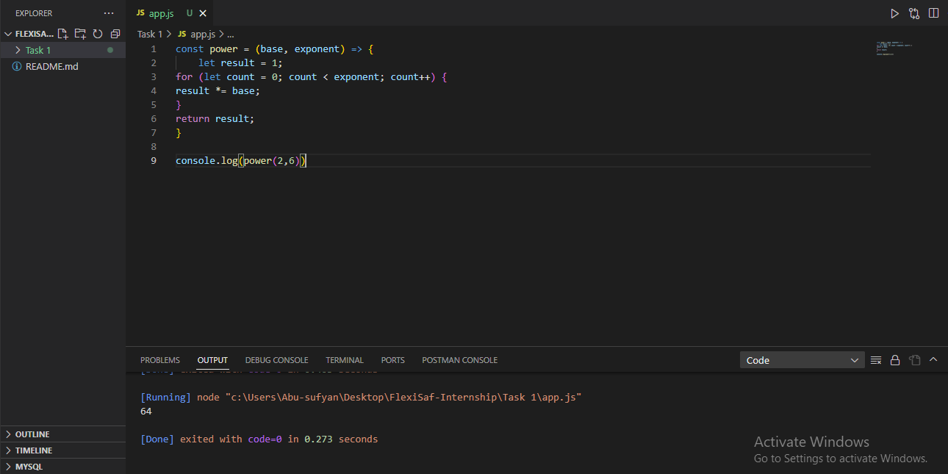
Arrow Function
ES6 Arrow functions provides alternative way to write a shorter function syntax.
Although shorter it has differences from the original function such as the not having bindings to this or super.

Slide 5
Arrays
An Array is an ordered list of values. Each value is called an element which is specified by an index.
Arrays has multiple methods
Filter
forEach
Map
reduce

Slide 6
Objects
Cloudinary
Stripe

Slide 7
Thanks for reading

